Slide 1
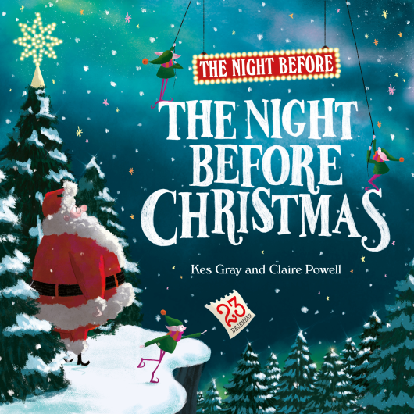
Notes for Teachers and Librarians on
The Night Before The Night Before Christmas by Kes Gray and Claire Powell
INTRODUCTION
The Night Before The Night Before Christmas, written by Kes Grey and illustrated by Claire Powell, is the perfect EYFS picture book for children ages 3+; ideal for reading aloud at any time of year. These notes include reading comprehension questions to improve literacy, as well as suggestions for classroom activities to enjoy the book across the curriculum – from matching rhyming words, to using musical instruments to show the meaning of the words, and drawing pictures of their favourite toys in Santa’s workshop!
ABOUT THE BOOK
Santa and his elves are rushed off their feet preparing for Christmas Eve. There are presents to make, reindeer to wake and a sleigh to polish. But what has Santa forgotten to do?
Inspired by Clement C. Moore’s original festive tale and written by Kes Gray, the best selling author of Oi Frog, The Night Before The Night Before Christmas is a fun-filled Christmas classic in the making.
The Night Before The Night Before Christmas
by Kes Gray and Claire Powell

Slide 2
Notes for teachers and librarians on
The Night Before The Night Before Christmas
by Kes Gray and Claire Powell
READING GROUP QUESTIONS
1. What are the different elves doing on the first page of the story? Can you act out what the green elves, the blue elves and the red elves are doing?
2. Why does Santa want all the elves to ‘Be quick!’?
3. How many presents do the elves need? Why do you think they need so many?
4. Look at the pictures at the beginning of the book; can you find the skateboards, yo-yos, dollies and teddies mentioned in the story?
5. Why does Santa turn ‘with a jump’? Who surprises him at the door?
6. Santa tells Mrs Claus that he has ‘no time to eat!’ – why do you think this is?
7. What are the names of the eight reindeer? How long have they been asleep for?
8. What colours have the elves painted Santa’s new sleigh?
9. Is Santa happy with his new sleigh? How do you know?
10. What do the elves have to do when they have finished making the toys, using paper, scissors, labels and pens?
11. How big is Santa’s sack? How can you tell that it’s big from looking at the picture?
12. What do we finally find out that Santa has forgotten to
do?
The Night Before The Night Before Christmas
by Kes Gray and Claire Powell

Slide 3
Notes for teachers and librarians on
The Night Before The Night Before Christmas
by Kes Gray and Claire Powell
SUGGESTED ACTIVITES
Literacy
• Pick some of the different rhyming words from the story and hide them around the classroom. Can children find them and match them together?
• Write a series of questions for the different characters in the book to answer. Ask children to match the question to the right character and to then try to answer it for that character. Sample questions might include the following:
    How did you feel when you felt like you’d forgotten something?
    How did you feel when Santa was shouting at you to ‘be quick!’?
    How did you feel when Santa let your dinner go cold?
• Read the story aloud as a class. Ask children to pick a section in groups and create actions to go with the words. Read aloud as a class again but with the different groups reading their allocated sections. Asking children to use musical instruments to show any important moments or emotions in the story could extend this activity.
• Ask children to create a Christmas list or a letter to Santa asking him for their favourite toys and giving reasons why they should receive them.
• Pick out any difficult words from the story and ask children to try to match them to their definition using the context of the sentence to help them (e.g. ‘shirk’ or ‘hump’).
Drama & Speaking and Listening
• As a class, either act out the scene at the beginning of the story where Santa is ordering the elves to ‘Be quick!’ or where the elves unveil the new sleigh. Children should take it in turns to play Santa. Each time they complete a scene, ask children to record how they feel. What emotions do the elves and Santa experience – are they the same or different?
• In pairs, children could create a freeze-frame to show how Mrs Claus feels when she stands in the doorway with ‘the hump’. How can they use their body
language and facial expressions to show the relationship
between Mrs Claus and Santa and their different emotions
in this scene?
The Night Before The Night Before Christmas
by Kes Gray and Claire Powell

Slide 4
Notes for teachers and librarians on
The Night Before The Night Before Christmas
by Kes Gray and Claire Powell
SUGGESTED ACTIVITES CONTINUED
Art and Design
• Draw some of the toys from the story. Which toy would the children ask for?
• Ask children to pick their favourite character from the story to create a mask for that character. They could then act out one of the scenes from the story in-role as their chosen character, wearing their masks.
Maths
• Children can use the story to improve their concept of time. Ask them to create a list of the days of the week leading up to Christmas, and to mark the different events of the story on their corresponding days.
• Can children create a clock face using a blank template to show the countdown to Christmas Day?
The Night Before The Night Before Christmas
by Kes Gray and Claire Powell

